Slide 1


MINI PROJECT PRESENTATION
BACHELOR OF TECHNOLOGY
(COMPUTER SCIENCE ENGINEERING)
SESSION 2020-2021
JAINUL HASAN (19BCS041)

Slide 2

CATTY
A virtual voice assistant using python

Slide 3

TABLE OF CONTENTS
INTRODUCTION
01
FEATURES
02
03
MODULES USED
FUTURE PROSPECTIVE
05
04
RESOURCES & CERTIFICATES

Slide 4


INTRODUCTION
In this project I am implementing the basic idea of voice assistants using python, I implemented the basic understanding of python and python modules learned by courses of coursera, how it works and how it can be developed as per users requirement with the help of python modules. I made a personal voice assistant CATTY which performs various tasks given by user through voice commands.
The CATTY can understand and react to specific commands. Asking the voice assistant for today’s date and time is a good example. The assistant will decipher the human voice command and then act independently by searching the web for the right answer and reading it back to the user.

Slide 5

HOW IT WORKS?
CATTY
VOICE ASSISTANT
The voice assistant records the speech, removing any background noise and splitting the speech into its component parts. The speech is transcribed into what the assistant thinks is the most probable sentence, based on the patterns of these sounds. The assistant determines the most important words and most likely intent of the text.

Slide 6

BENEFITS
Using your voice will always be quicker, much more natural, and lead to less spelling errors. This leads to a much more efficient and natural intelligent workflow.
One of the greatest benefits of voice assistants is a quick learning curve. Instead of having to learn how to use devices, you can just use your natural conversation tendencies and use your voice.
Since a screen or keyboard isn’t necessary, it’s easy to place voice integration into a much wider array of devices. In the future, smart glasses, furniture, appliances, will all come with voice assistants already integrated into the device.

Slide 7

WHY PYTHON
Python focuses on code readability. The language is versatile, neat, easy to use and learn, readable, and well-structured.
You can find a library for basically anything you could imagine: from web development, through game development, to machine learning.

Slide 8

Python is the fastest growing programming language according to StackOverflow Trends.
Indeed.com, a worldwide employment-related search engine for job listings, ranked Python as the third most profitable programming language in the world.

Slide 10
FEATURES
It can change its voice from female to male and vice-versa
It can tell you date and time
It can tell cpu usage & battery
It can search things on wikipedia
It can create the reminder list
It can shutdown or restart your system
It can open any website
It can tell you non funny jokes

Slide 11

SATURN

Slide 12

FOR WIKIPEDIA
FOR FEATURES
KEYWORDS
EXIT
TO OPEN WEBSITE
WIKIPEDIA
WHERE
WHAT
WHEN
WHO
TELL ME YOUR POWERS
FEATURE
HELP
I AM DONE
BYE BYE CATTY
GO OFFLINE CATTY
BYE
NOTHING
OPEN WEBSITE
OPEN YOUTUBE
OPEN NETFLIX
OPEN AMAZON
OPEN FLIPKART

Slide 13

SYSTEM
TO DO LIST
KEYWORDS
CHANGING VOICE
CPU & BATTERY USAGE
Restart
Shutdown
Voice
Cpu usage
battery

Slide 14

OTHER TASKS KEYWORDS
TELL ME TODAY’S DATE
TELL ME CURRENT TIME
TELL ME ABOUT YOURSELF
TELL ME A JOKE

Slide 15
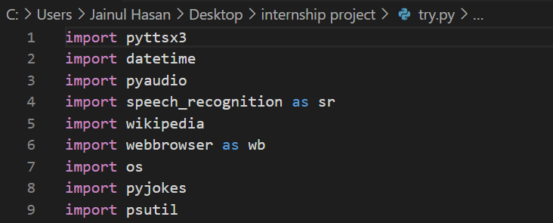
MODULES/LIBRARIES USED

Slide 16
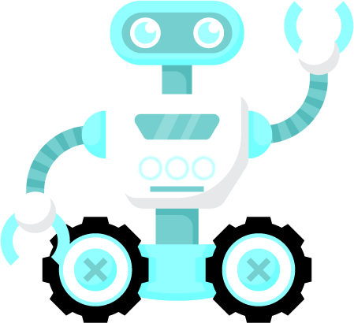
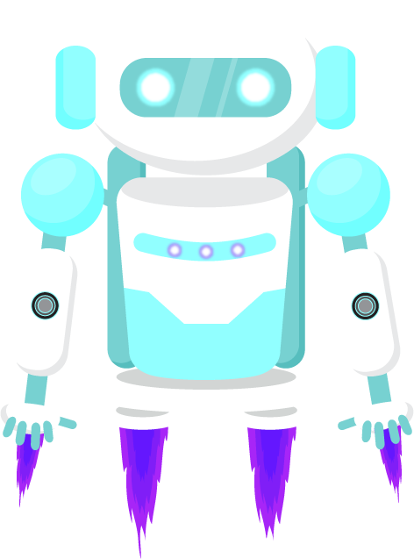
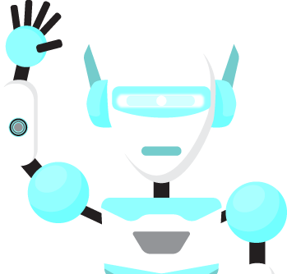
os
The OS module in python provides functions for interacting with the operating system.
SPEECH RECONITION
Speech recognition has various applications ranging from automatic transcription of speech data (like voice commands) to interacting with assistants via speech.
WEBBROWSER
In Python, webbrowser module provides a high-level interface which allows displaying Web-based documents to users. The webbrowser module can be used to launch a browser in a platform-independent manner

Slide 17
WIKIPEDIA
This is used to extract data and information from Wikipedia, as it is the largest and most popular source of information on the internet
pyttsx3
pyttsx3 is a text-to-speech conversion library in Python. Unlike alternative libraries, it works offline and is compatible with both Python 2 and 3.
Pyaudio
With PyAudio, you can easily use Python to play and record audio on a variety of platforms.

Slide 18
psutil
psutil is a Python cross-platform library used to access system details and process utilities. It is used to keep track of various resources utilization in the system.
datetime
In Python module named datetime can be imported to work with the date as well as time. datetime module comes built into Python.
pyjokes
pyjokes is used for collection Python Jokes over the Internet.

Slide 19
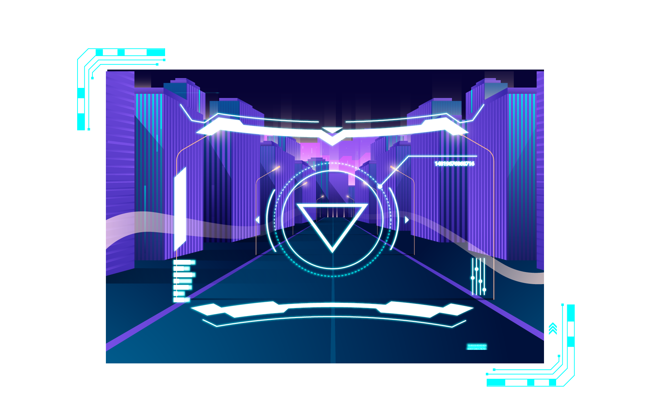

FUTURE PROSPECTIVE
CATTY

Slide 20
As AI becomes more advanced and voice technology becomes more accepted, not only will voice controlled digital assistants become more natural, they will also become more integrated into more daily devices. Also, conversations will become much more natural, emulating human conversations, which will begin to introduce more complex task flows. More and more people are using voice assistants too, as it was estimated in early 2019 that 111.8 million people in the US will use a voice assistant at least monthly, up 9.5% from last year.

Slide 21
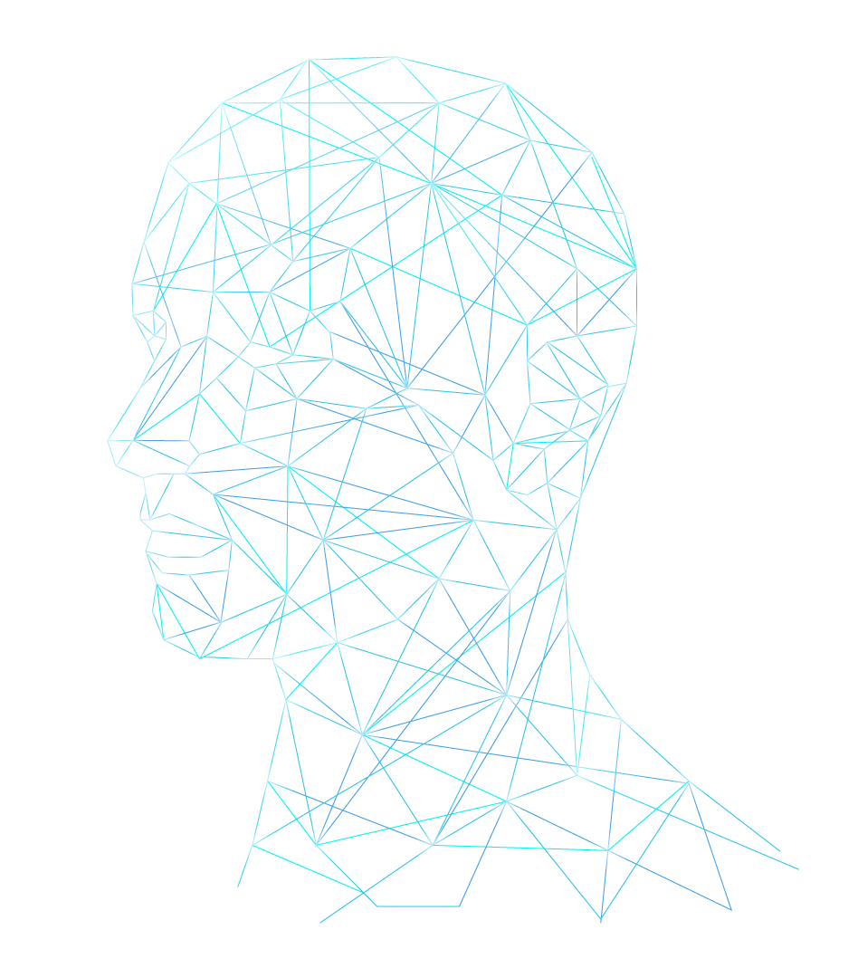
The importance of “voice” is undeniable. For this very reason, companies are already figuring out the best ways to make use of voice assistants and integrating them into their marketing and customer services. To be on top of the game, it is especially important to focus on the new ways customers might interact with voice-enabled machines and develop strategies accordingly.

Slide 22
At the end of 2020, there will be 4.2 billion digital voice assistants being used in devices around the world.

Slide 23
WHERE PEOPLE USE VOICE ASSISTANTS
AT HOME
Majority of people uses voice assitant while cooking. We can add voice features in ovens and other appliances of home
39%
CAR
51%
IN PUBLIC
This can be seen as major area of implement and development voice assistant in future In the era of covid pandemic voice assistants can be used in public place due to which physical contacts with the device/setups can be reduce which can further reduce the spread of virus.
It provides a safety while driving, we can develop more and more features in assistant so driver will not lose attention which can prevent accidents
6%

Slide 24
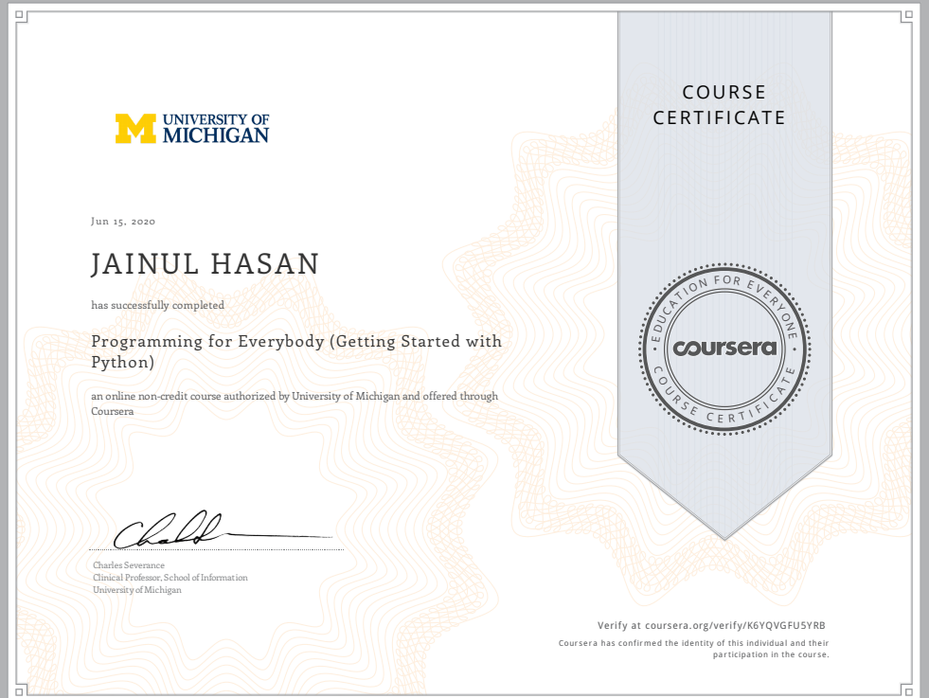
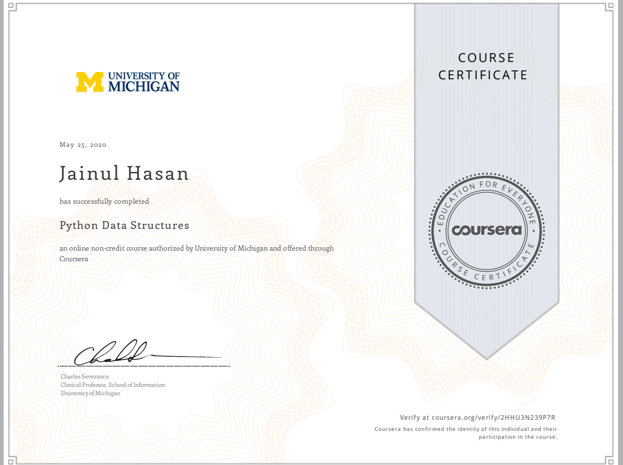
CERTIFICATES

Slide 25
RESOURCES
https://whatis.techtarget.com/definition/voice-assistant
https://www.smartsheet.com/voice-assistants-artificial-intelligence
https://www.geeksforgeeks.org/voice-assistant-using-python
https://www.python.org
https://www.thinkwithgoogle.com/consumer-insights/consumer-trends/voice-assistance-typical-weekly-tasks
https://www.statista.com/statistics/973815/worldwide-digital-voice-assistant-in-use

Slide 26

THANKS!

